Slide 1

Building a Mobile Location Aware System with Beacons
Jonathan LeBlanc (@jcleblanc)
Head of Global Developer Advocacy at PayPal + Braintree

Slide 2
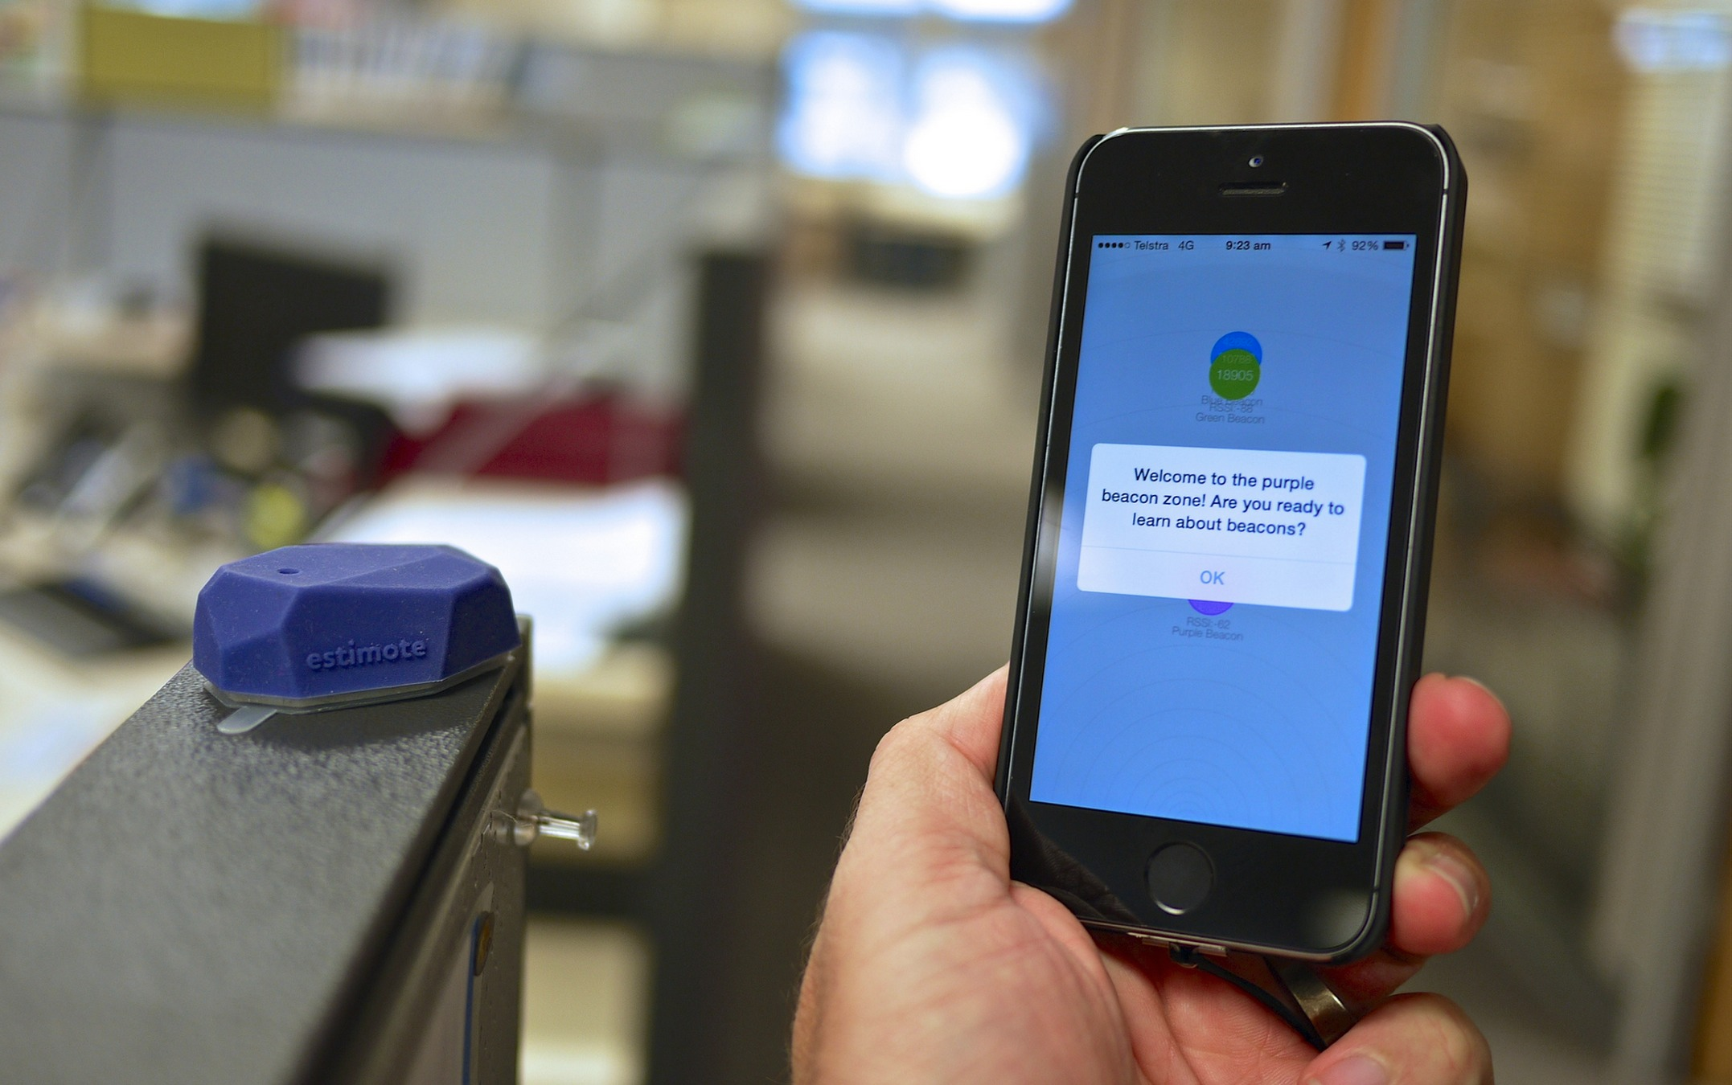
Purpose of a Beacon
twitter: @jcleblanc | hashtag: #devnexus

Slide 3
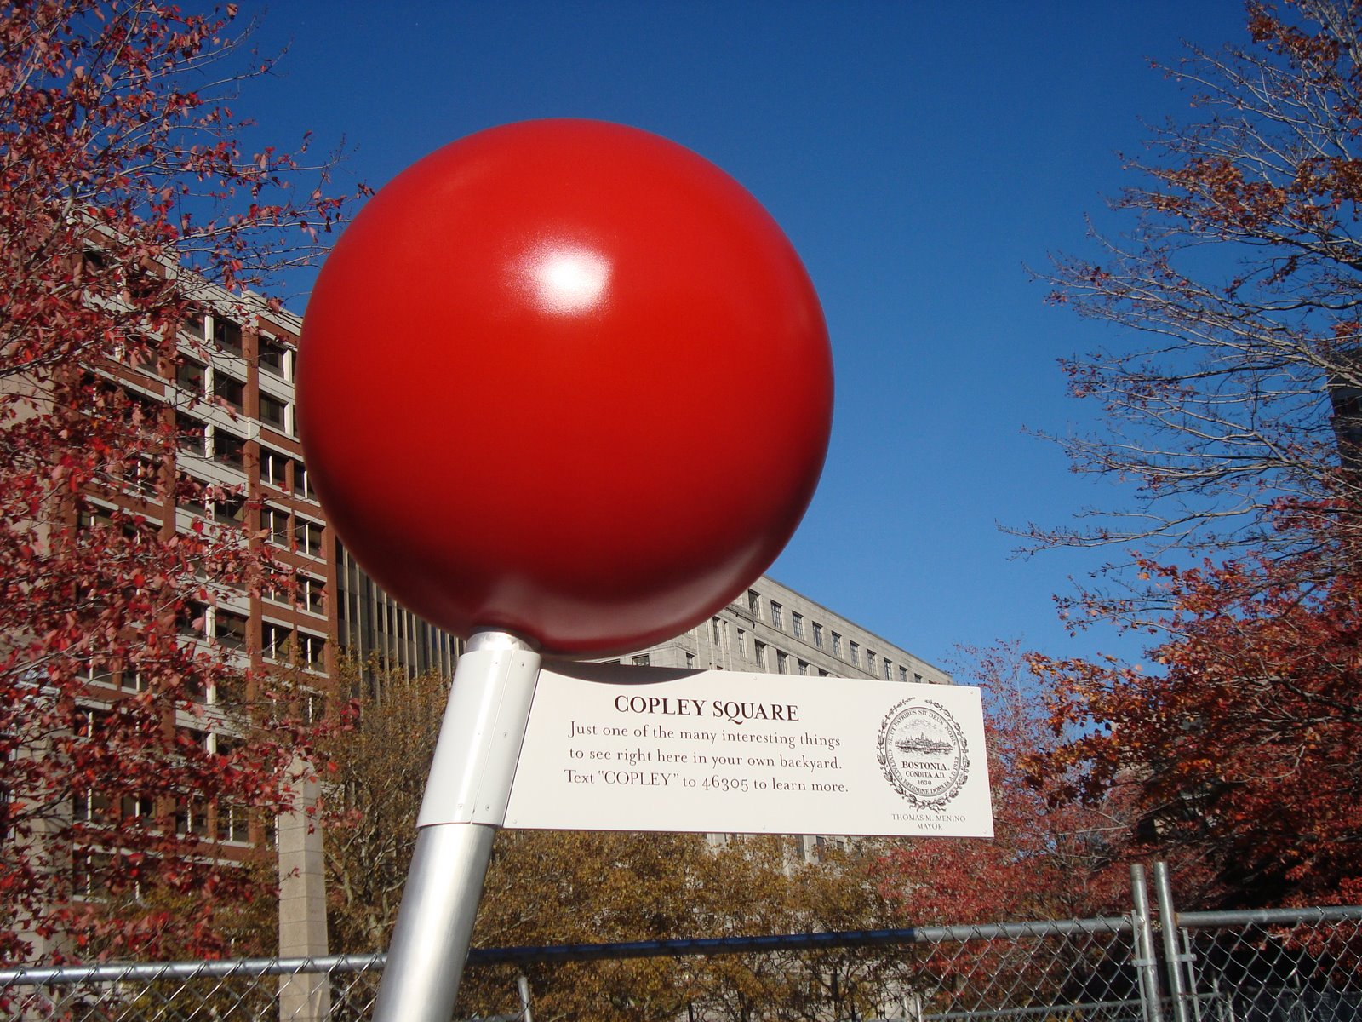
Being Location Aware

Slide 4
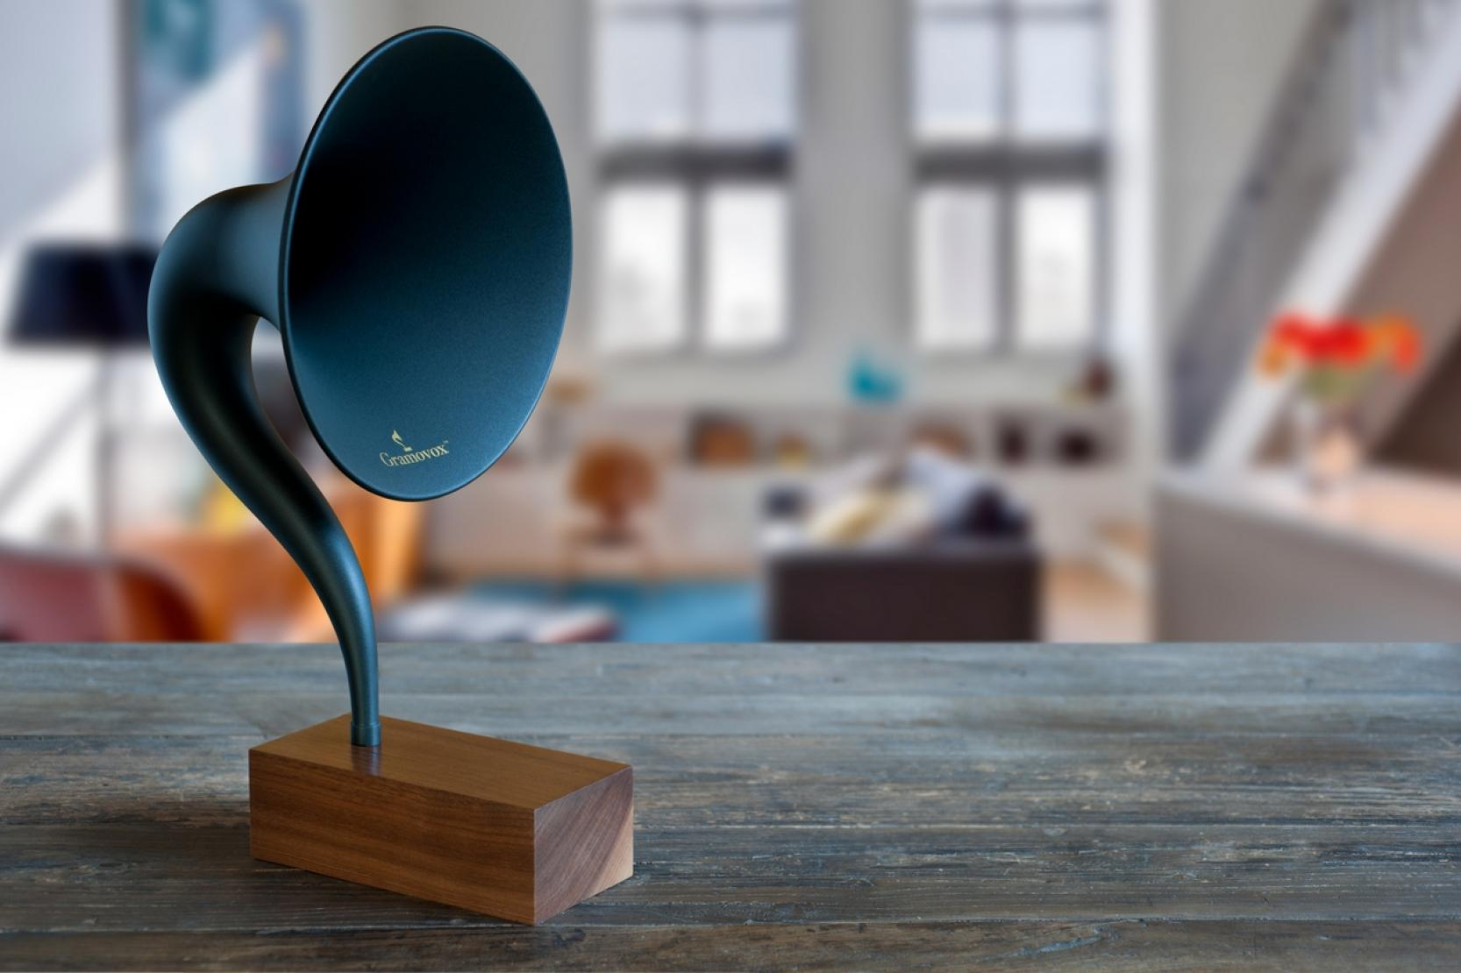
The Bluetooth Spec
twitter: @jcleblanc | hashtag: #devnexus

Slide 5
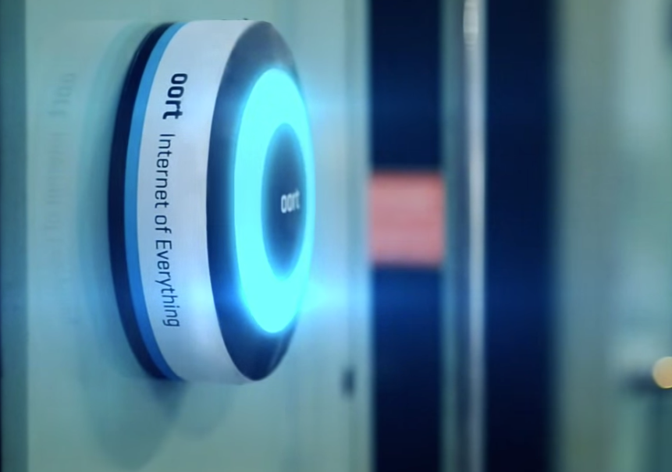
Bluetooth vs Bluetooth Smart
twitter: @jcleblanc | hashtag: #devnexus

Slide 6



How it Works
Central
Device
Beacon
Hardware
IP Address
Endpoint
twitter: @jcleblanc | hashtag: #devnexus

Slide 7
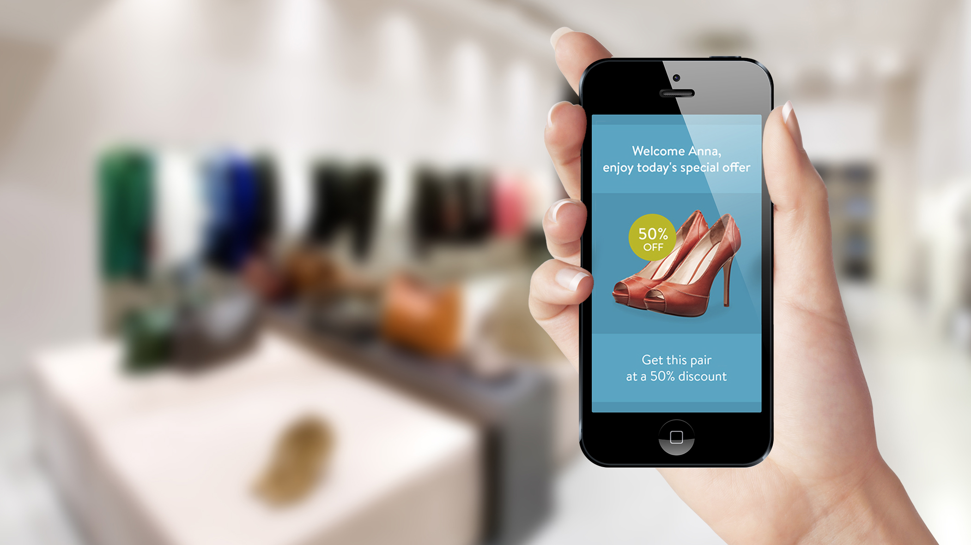
Real World Use Case
twitter: @jcleblanc | hashtag: #devnexus

Slide 8

Don’t be Creepy
twitter: @jcleblanc | hashtag: #devnexus

Slide 9
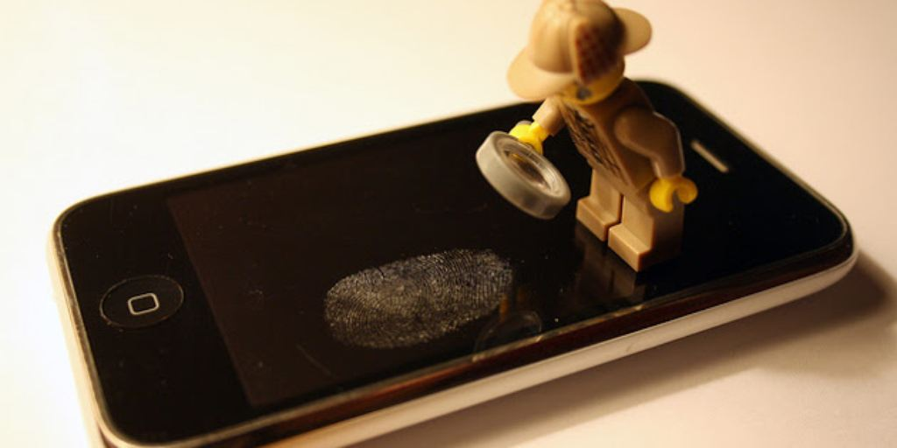
Bluetooth Smart Details
Connection Type: Intermittant
Battery Life: ~ 1.5 years (ha)
Range: ~ 75-100 meters
Data Latency: 3ms
twitter: @jcleblanc | hashtag: #devnexus

Slide 10

iBeacon Specification https://developer.apple.com/ibeacon/
twitter: @jcleblanc | hashtag: #devnexus

Slide 11
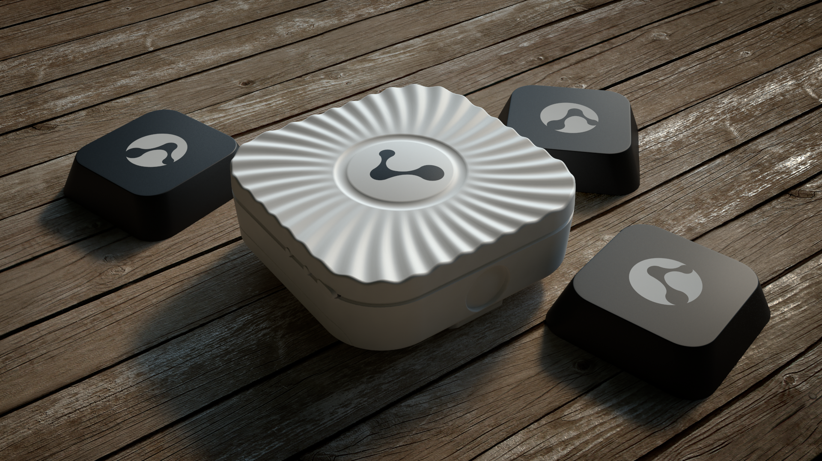
The Beacons
twitter: @jcleblanc | hashtag: #devnexus
Notes:
For ease of display, we’ll be working with Estimotes on Android

Slide 12
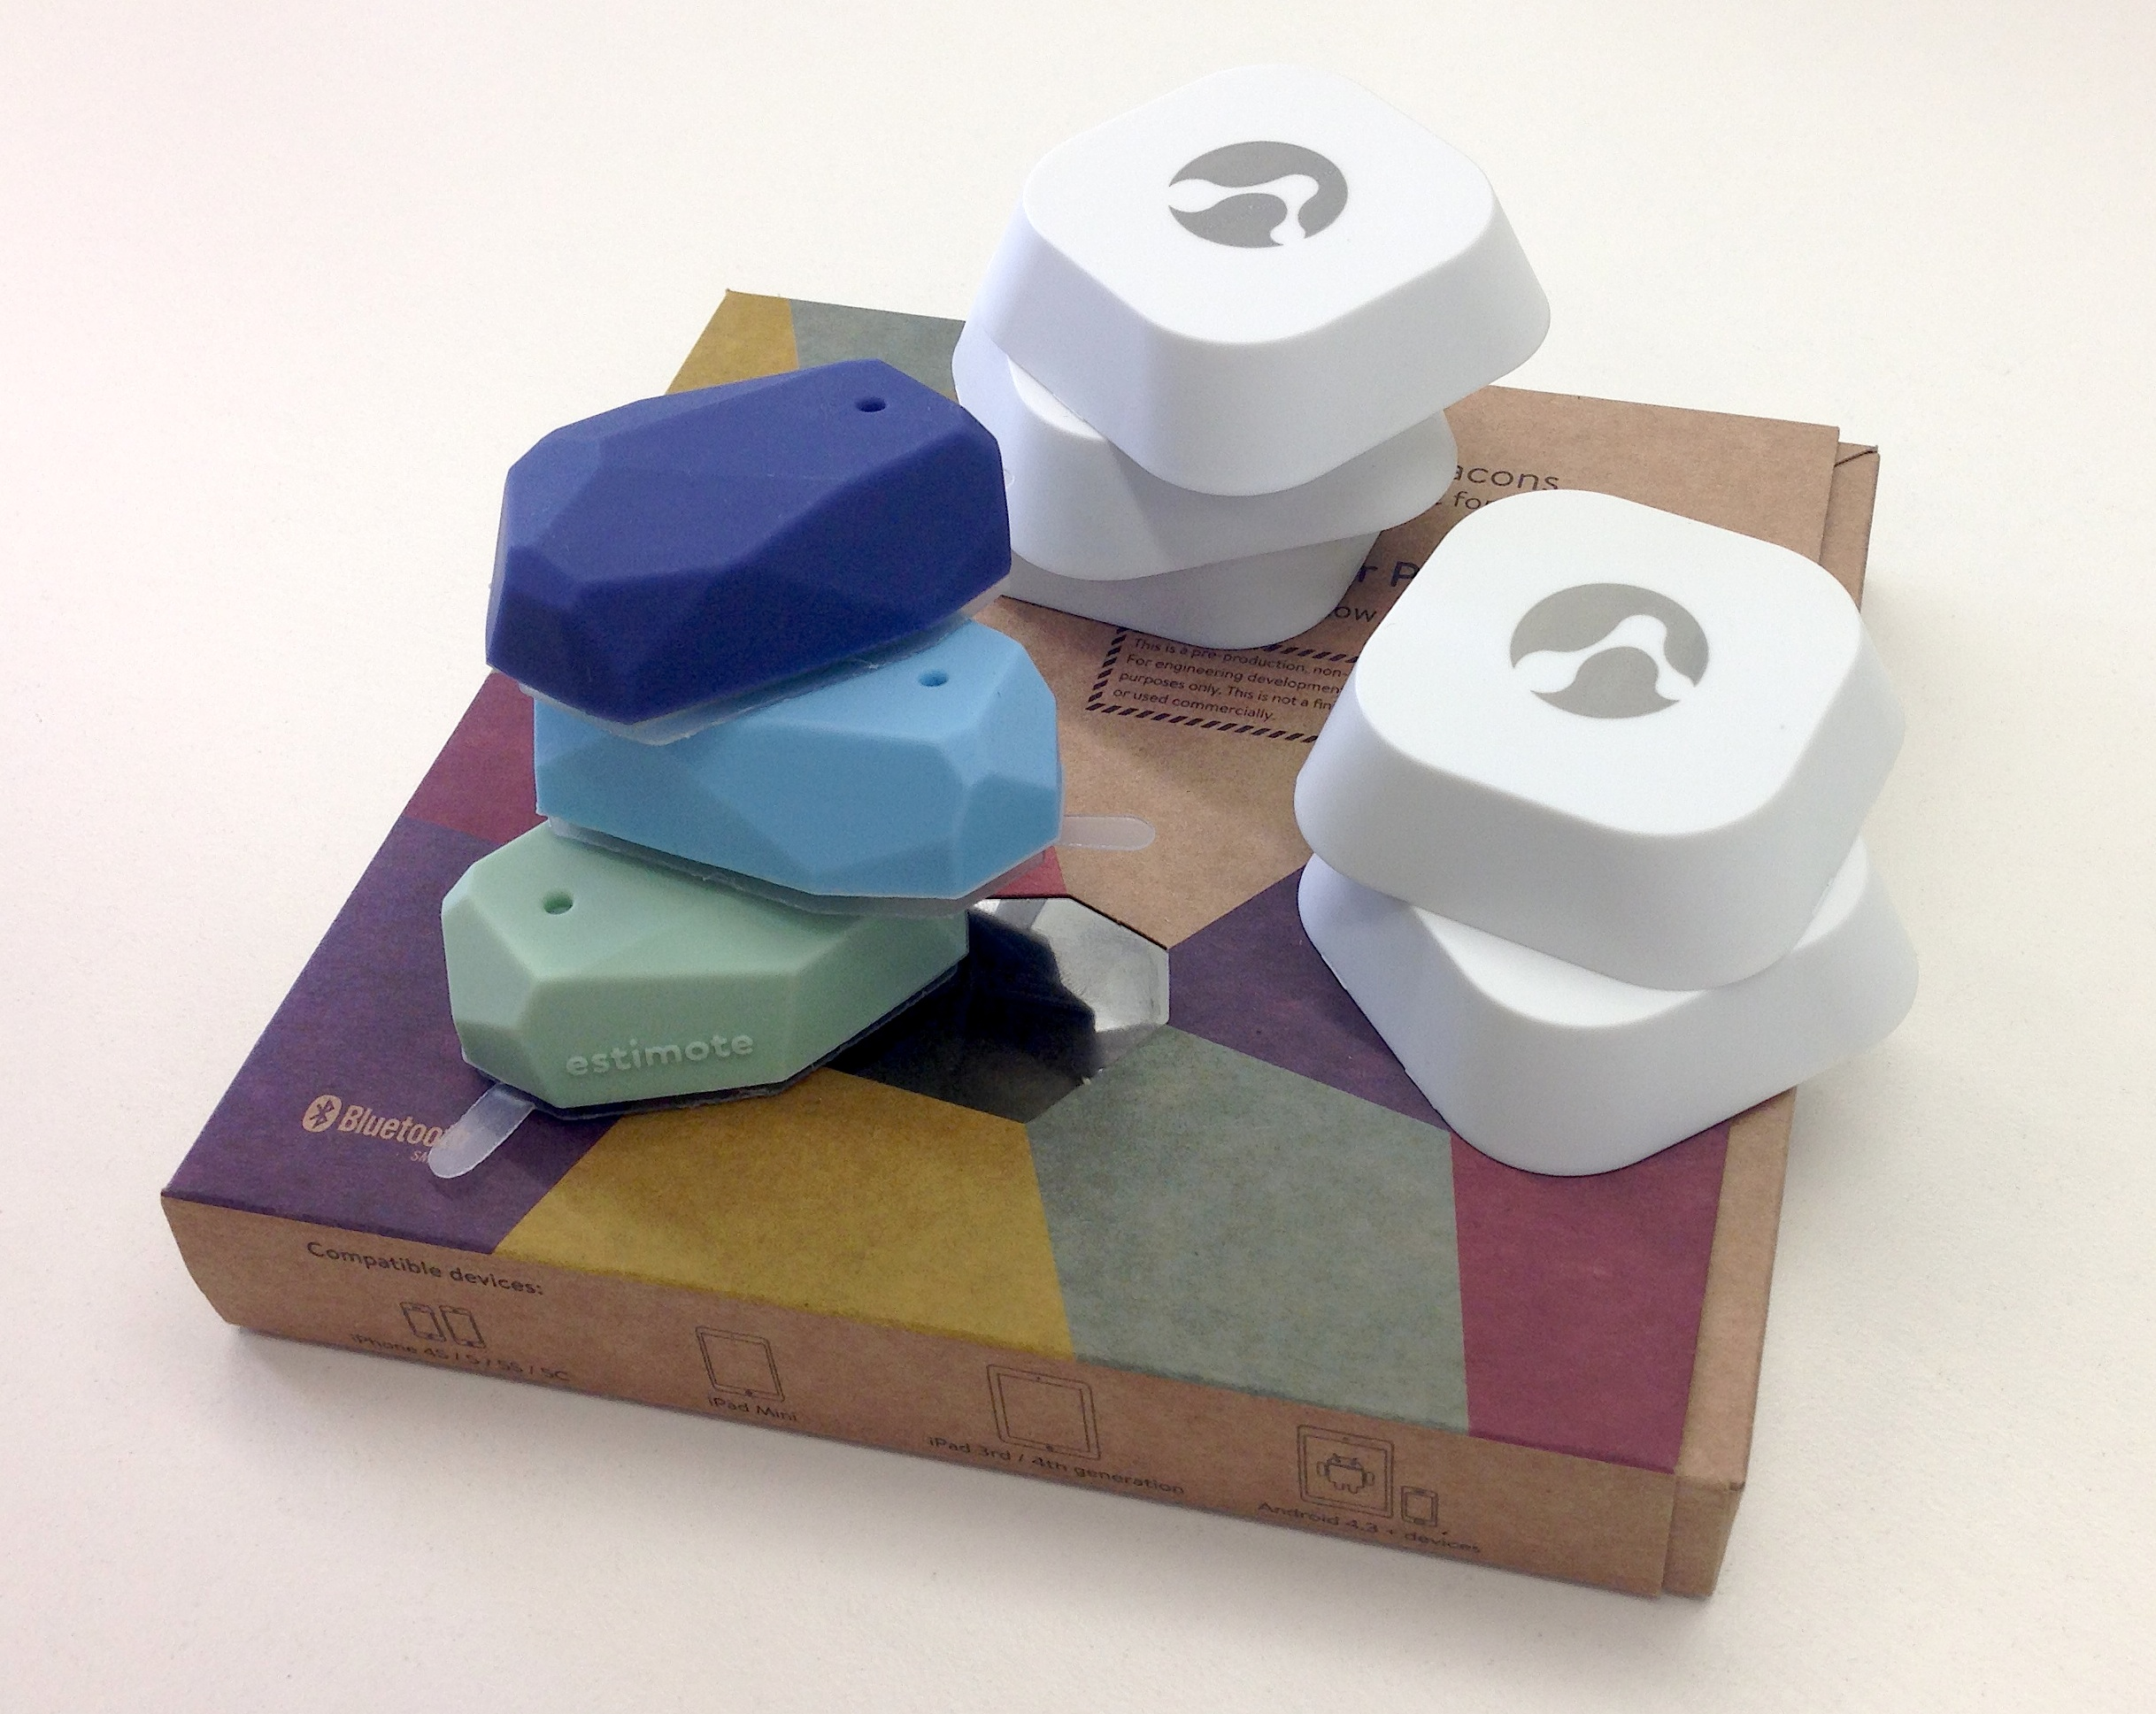
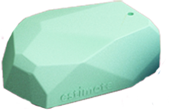

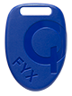

Beacon Comparison
Estimote: $99 / 3, temp + motion
Bluecat: Trial, AA batteries
Gimbal Tag: $5, small & deployable
Kontakt.io: $81 / 3, battery life
twitter: @jcleblanc | hashtag: #devnexus

Slide 13
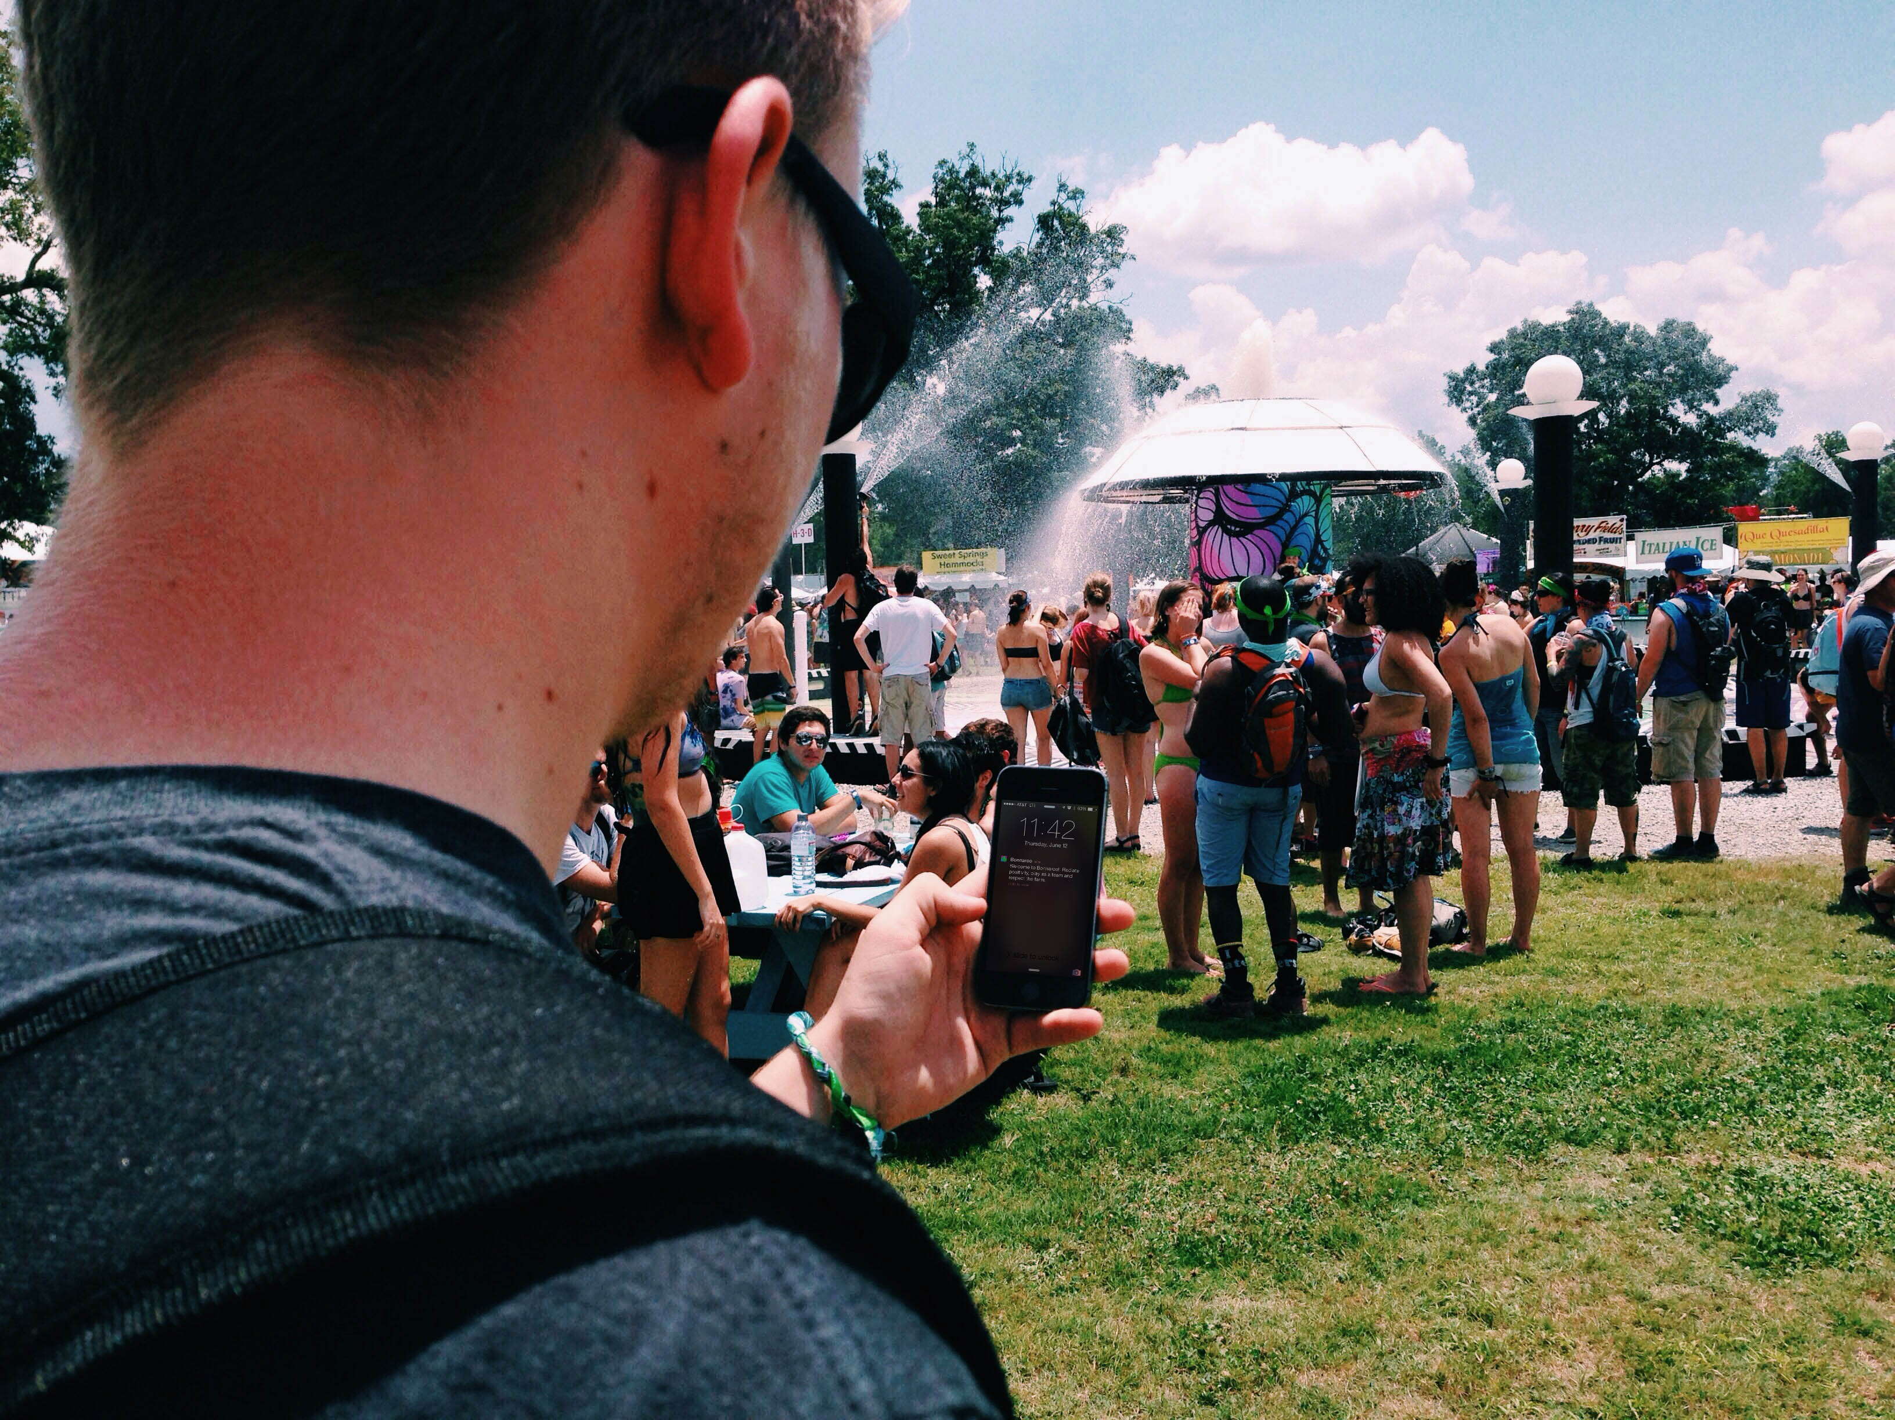
Beacon Advertisement & ID
UUID (16 bytes): Differentiates Large Group
Major (2 bytes): Beacon Subset
Minor (2 bytes): Individual Beacon
Tx Power: Proximity from beacon
twitter: @jcleblanc | hashtag: #devnexus
Notes:
UUID: 16 byte string used to differentiate a large group of related beacons
Major: 2 byte string used to distinguish a smaller subset of beacons within the larger group
Minor: 2 byte string meant to identify individual beacons
Tx Power: determine proximity (distance) from the beacon

Slide 14
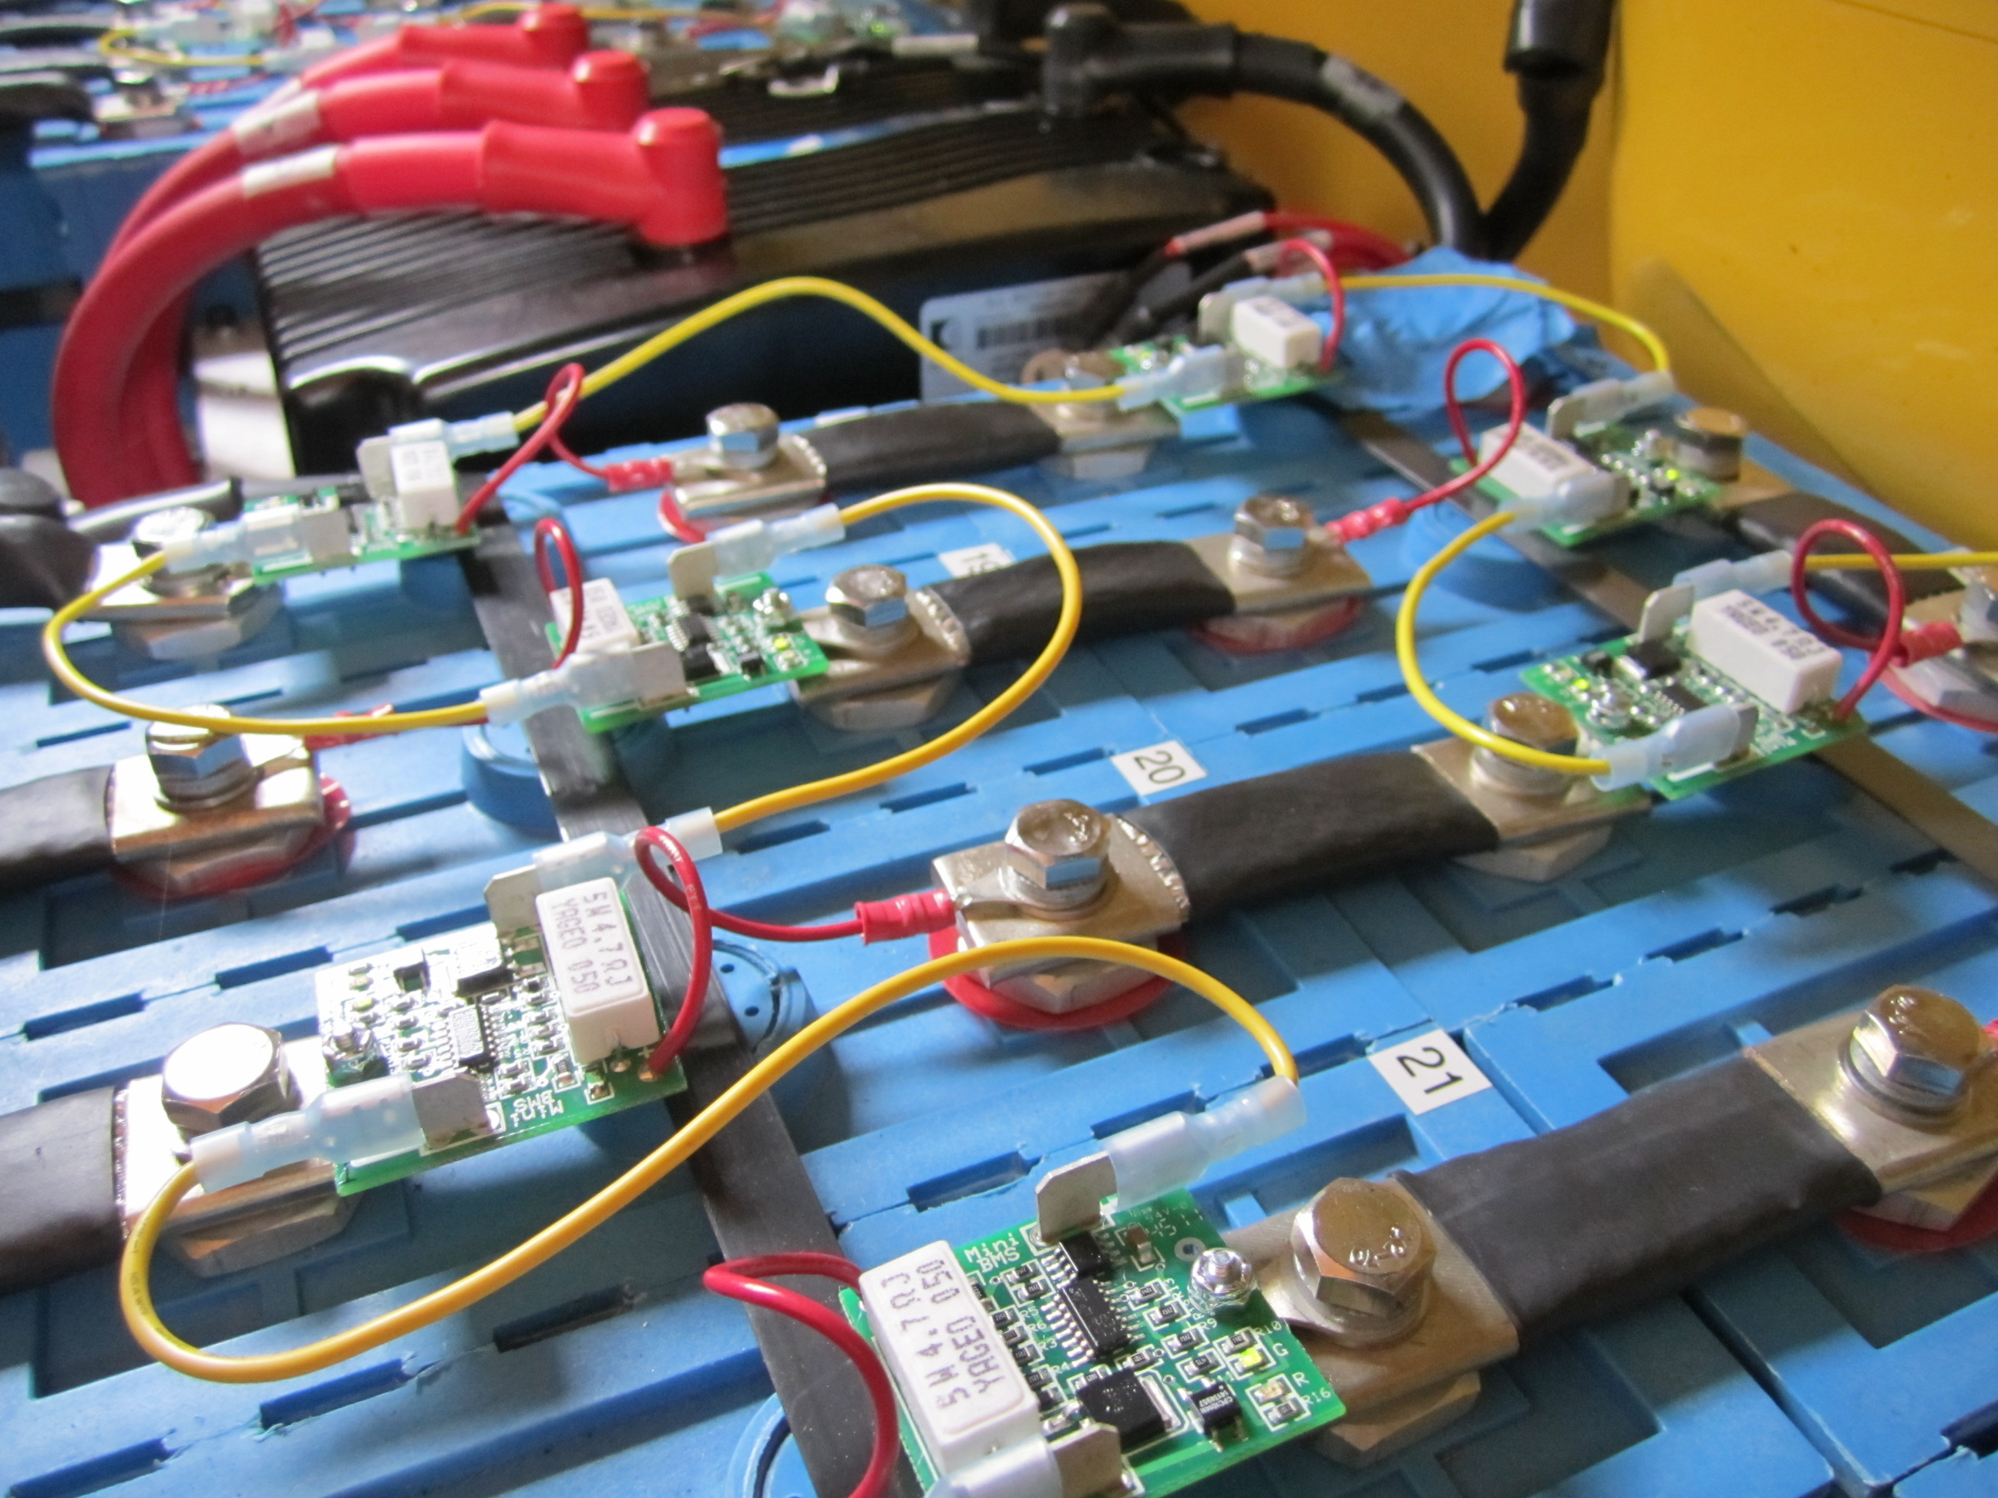
Battery Life vs Range
twitter: @jcleblanc | hashtag: #devnexus

Slide 15
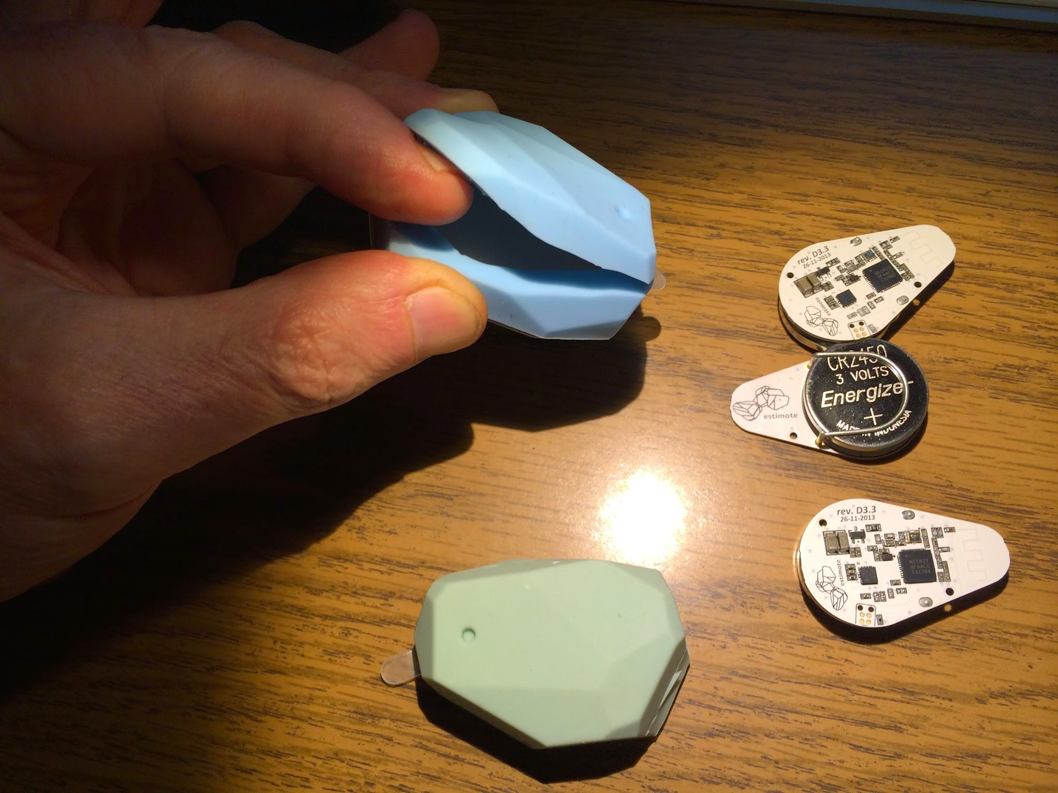
Battery Replacement
twitter: @jcleblanc | hashtag: #devnexus

Slide 16
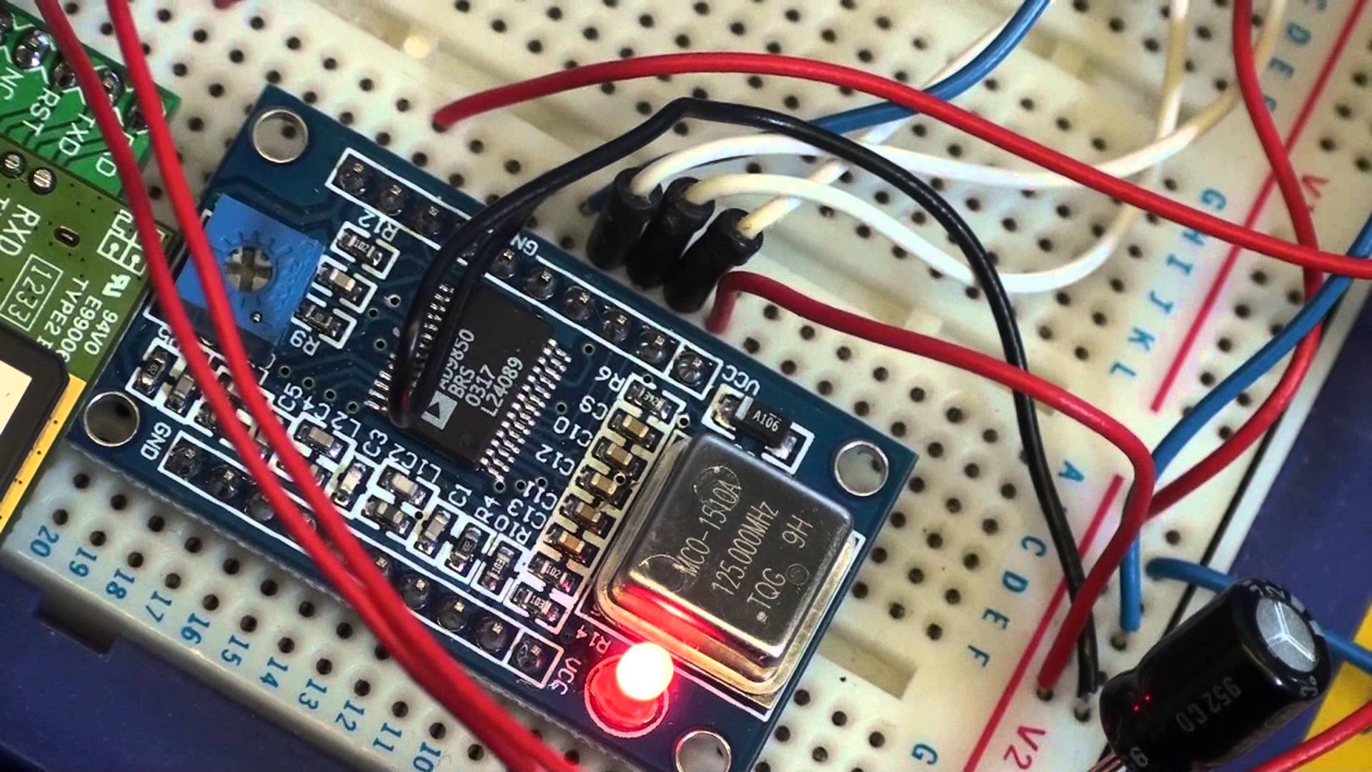
Creating Your Own Beacon
twitter: @jcleblanc | hashtag: #devnexus

Slide 17
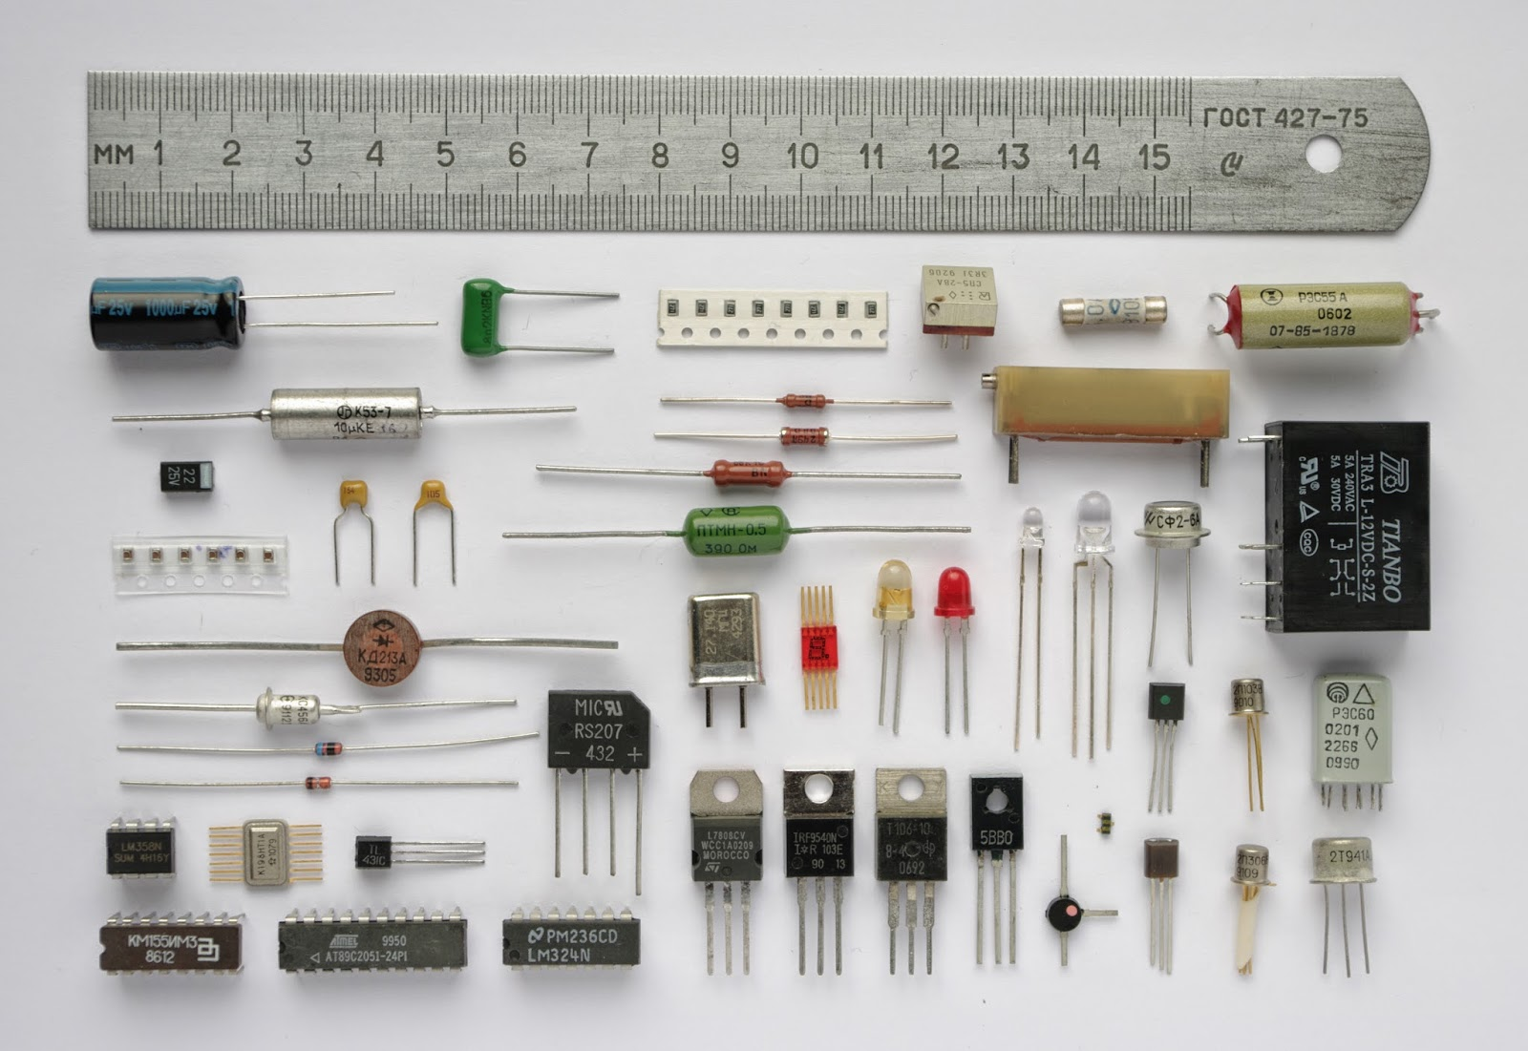
Component List
Microcontroller (Arduino, etc.)
Bluetooth Low Energy shield
Wi-Fi shield (optional)
Accelerometer (optional)
Human Sensor (optional)
twitter: @jcleblanc | hashtag: #devnexus

Slide 18
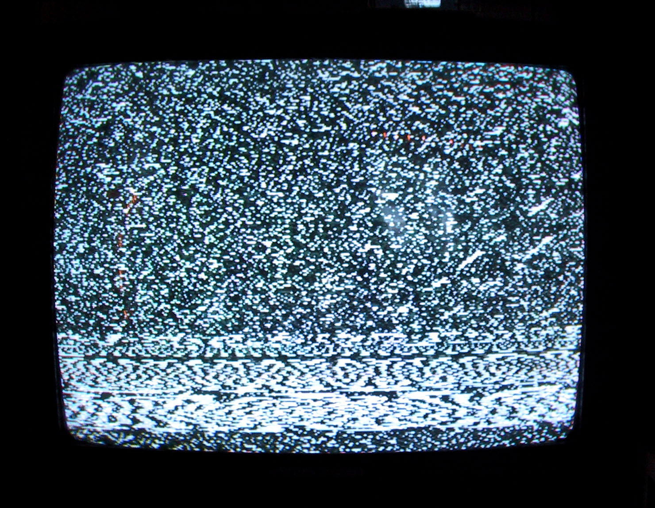
Signal Interference

Slide 19

Microwave ovens
Direct Satellite Service (DSS)
Certain external electrical sources
2.4 GHz or 5 GHz phones
Video transmitters/receivers that operate in the 2.4 GHz or 5 GHz bandwidth
Wireless speakers that operate in the 2.4 GHz or 5 GHz band
Certain external monitors and LCD displays
Any other wireless devices that operate in the 2.4 GHz or 5 GHz bandwidth
twitter: @jcleblanc | hashtag: #devnexus
Notes:
Sources of interference
Microwave ovens: Using your microwave oven near your computer, Bluetooth device, or Wi-Fi base station may cause interference.
Direct Satellite Service (DSS): The coax cable and connectors used with certain types of satellite dishes may cause interference. Check the cable for damage and obtain newer cables if you suspect RF leakage issues.
Certain external electrical sources such as power lines, electrical railroad tracks, and power stations.
2.4 GHz or 5 GHz phones: A cordless telephone that operates in this range may cause interference with wireless devices or networks when used.
Video senders (transmitters/receivers) that operate in the 2.4 GHz or 5 GHz bandwidth.
Wireless speakers that operate in the 2.4 GHz or 5 GHz band.
Certain external monitors and LCD displays: Certain displays may emit harmonic interference, especially in the 2.4GHz band between channels 11 and 14. This interference may be at its worst if you have a portable computer with the lid closed and an external monitor connected to it. Try changing your access point to use 5 Ghz or a lower 2.4 GHz channel.
Any other wireless devices that operate in the 2.4 GHz or 5 GHz bandwidth (microwaves, cameras, baby monitors, neighbors' wireless devices, and so on).

Slide 20
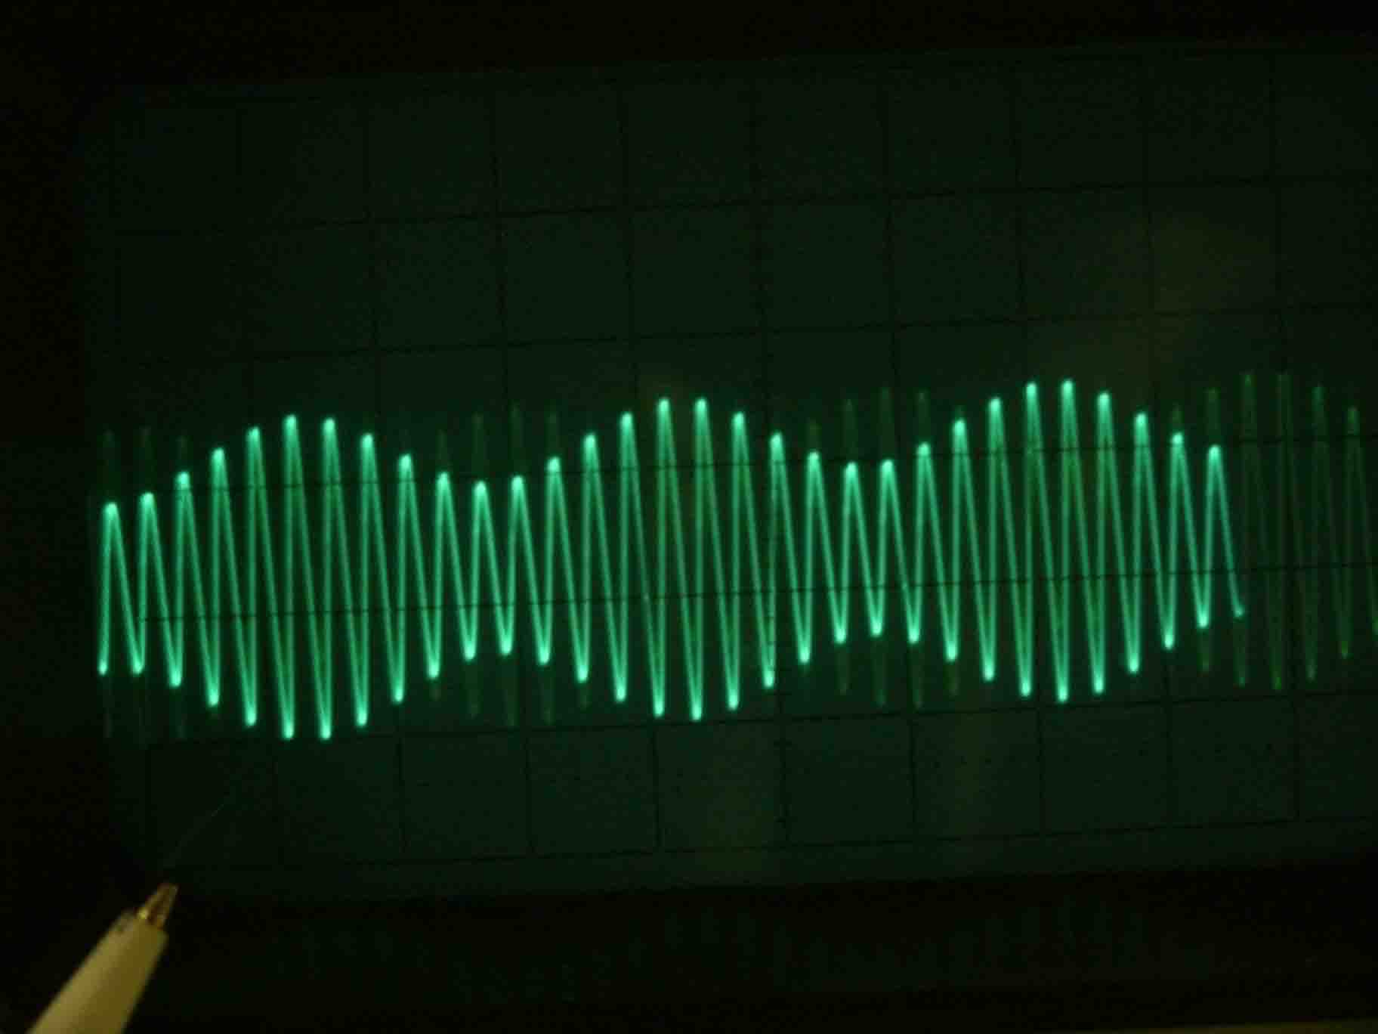
Signal Degradation

Slide 21
Low Interference
Medium Interference
Wood
Synthetic Material
Glass
Water
Bricks
Marble
High Interference
Very High Interference
Plaster
Concrete
Bulletproof Glass
Metal
Notes:
Things that create signal degradation – 3 levels of signal degredation
https://support.apple.com/en-us/HT201542
Low
Wood
Synthetic material
Glass
Medium
Water
Bricks
Marble
High
Plaster
Concrete
Bulletproof glass
Very High
Metal

Slide 22
Considerations
Trilateration algorithm
http://everything2.com/title/
http://stackoverflow.com/questions/20332856/triangulate-example-for-ibeacons
Band switching on degradation / interference
Secure and external communication
twitter: @jcleblanc | hashtag: #devnexus
Notes:
Considerations for proximity detection
http://stackoverflow.com/questions/20332856/triangulate-example-for-ibeacons

Slide 23

Getting Started
twitter: @jcleblanc | hashtag: #devnexus

Slide 24

Beacon SDK or Open SDK?
Estimote: http://estimote.com/api/
Kontakt.io: http://docs.kontakt.io/
AltBeacon: http://altbeacon.org/
examples/
twitter: @jcleblanc | hashtag: #devnexus

Slide 25
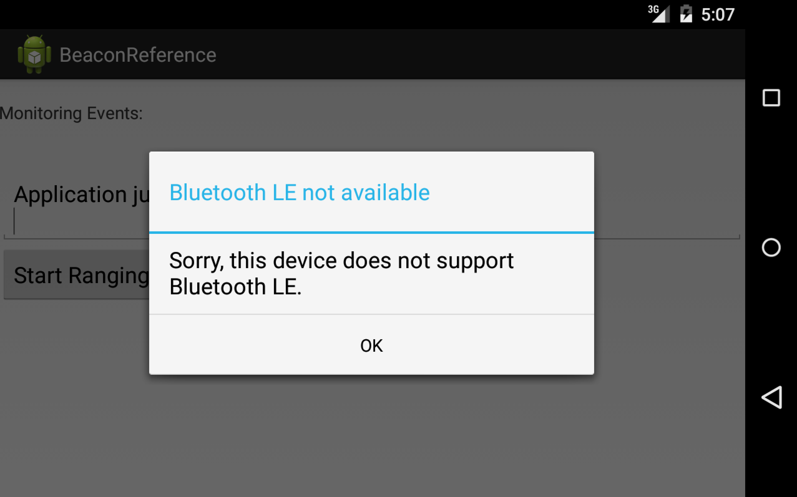
The Android Emulator
twitter: @jcleblanc | hashtag: #devnexus
Notes:
Have to use a physical device instead of the emulator
http://stackoverflow.com/questions/20348743/bluetooth-low-energy-on-android-emulator
Can work via virtualbox http://chrislarson.me/blog/emulate-android-and-bluetooth-le-hardware.html

Slide 26

Emulating Android & BLE
Virtual Machine Software +
USB BLE adapter
http://chrislarson.me/blog/emulate-android-and-bluetooth-le-hardware.html
twitter: @jcleblanc | hashtag: #devnexus

Slide 27
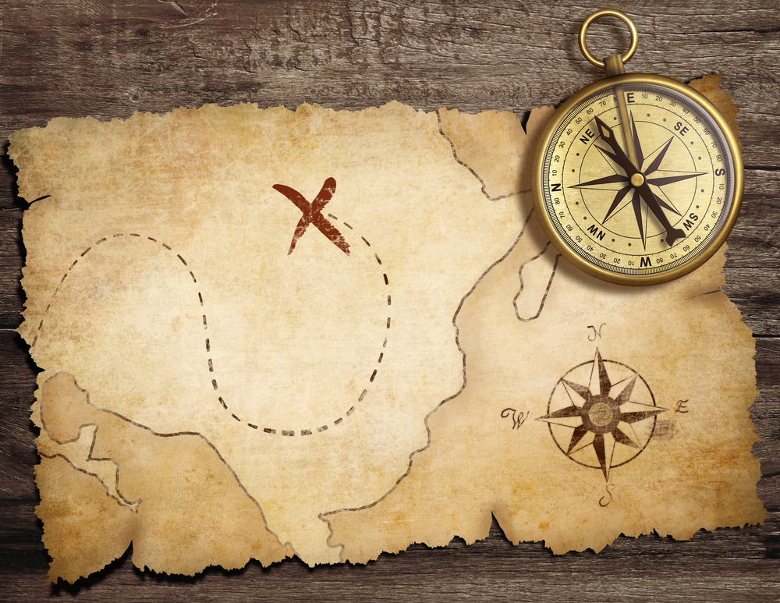
Beacon Scavenger Hunt
twitter: @jcleblanc | hashtag: #devnexus
Notes:
http://blog.shinetech.com/2014/02/17/the-beacon-experiments-low-energy-bluetooth-devices-in-action/

Slide 28
How it Works
Phone to Beacon Connections
Distance feedback system
Badges on beacon capture
Unlock on hunt completion
twitter: @jcleblanc | hashtag: #devnexus

Slide 29
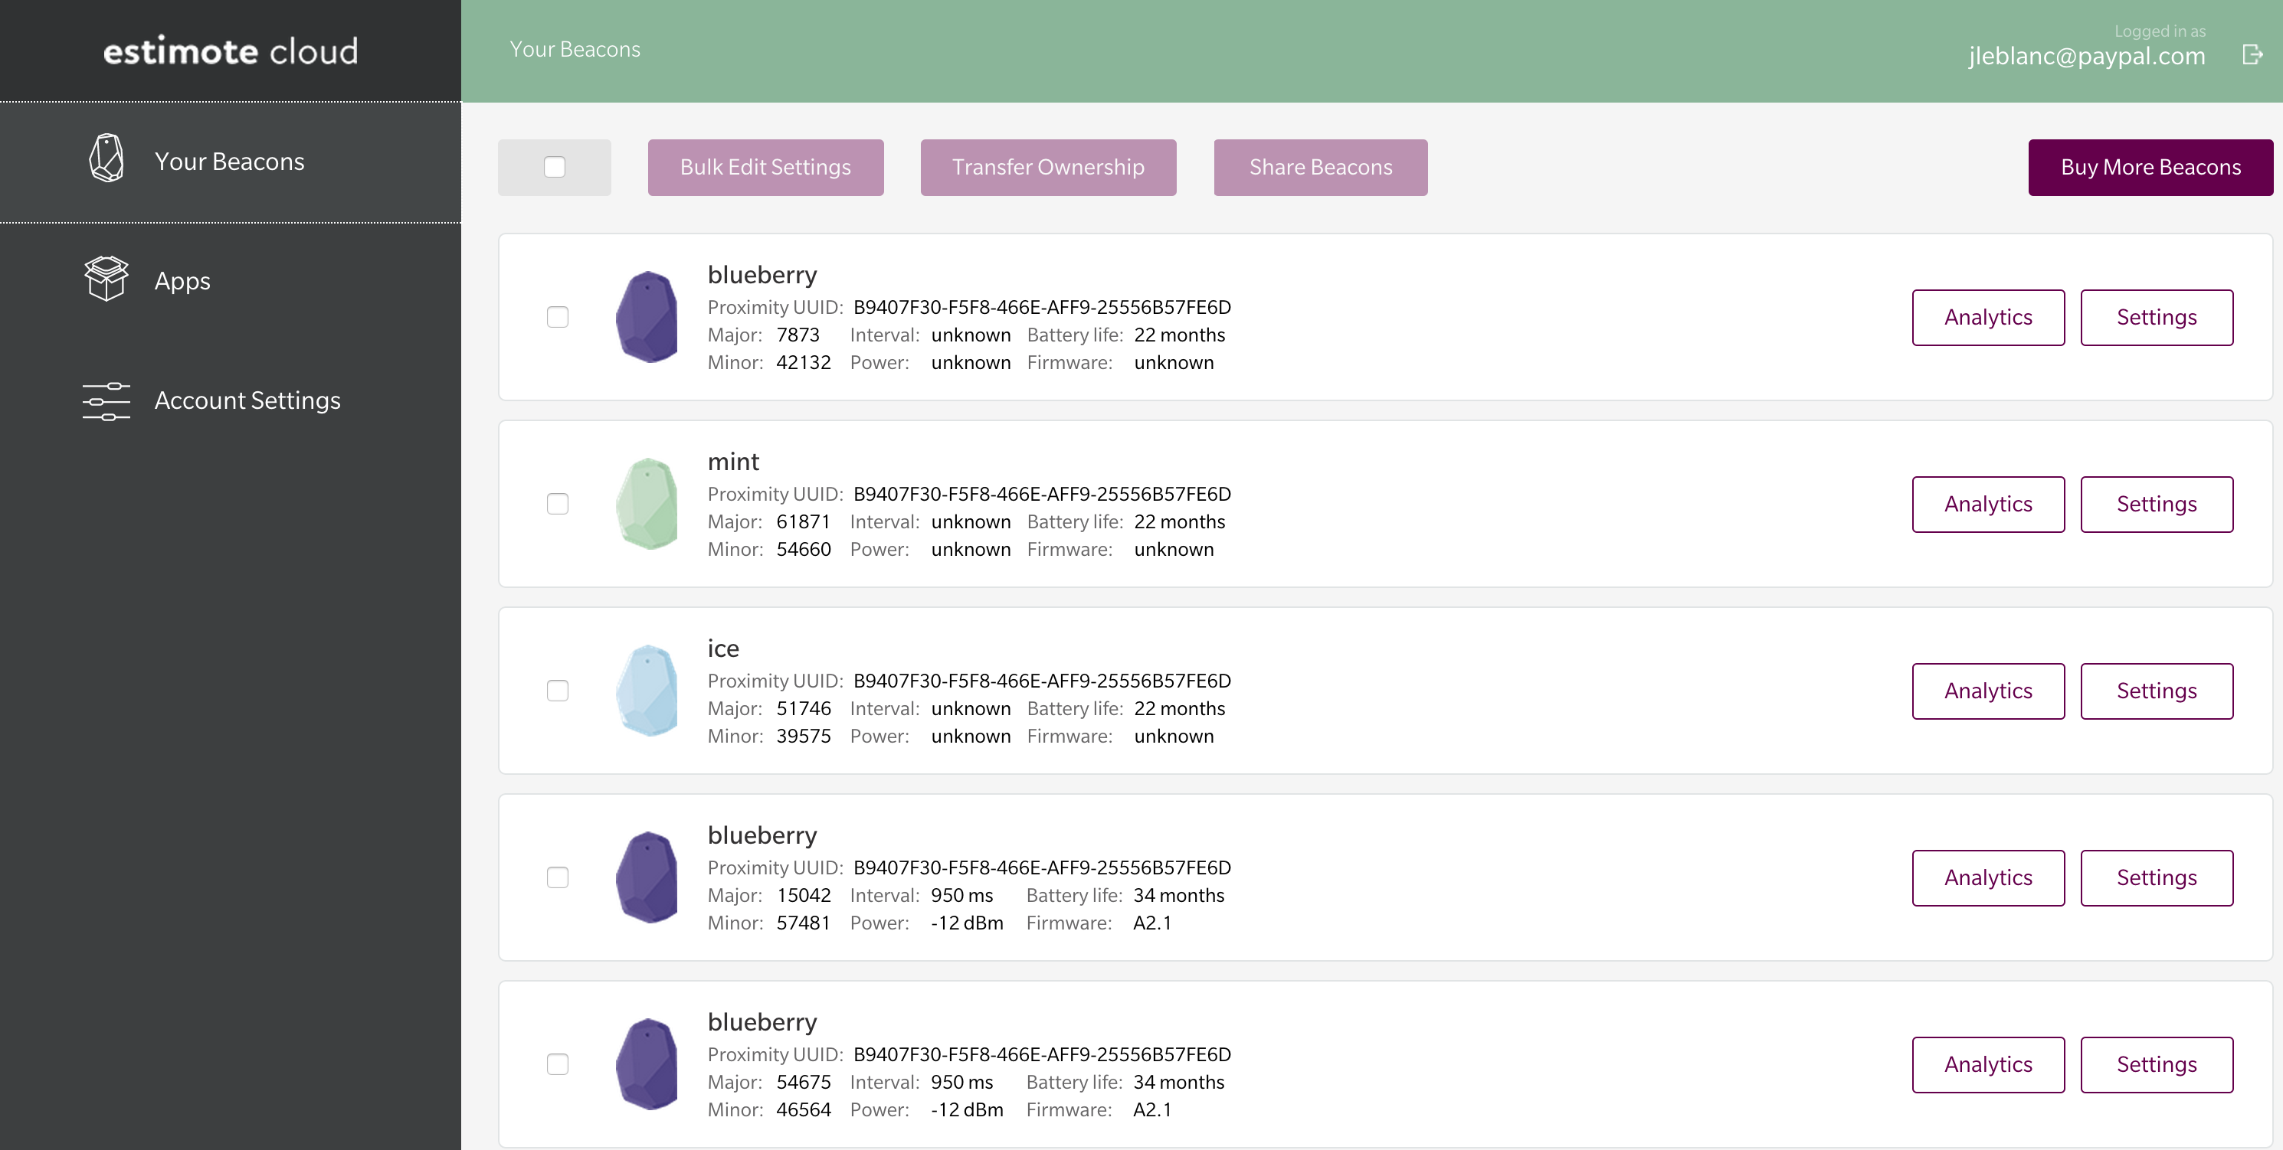
Adjusting Beacon Settings
Estimote Site and App
twitter: @jcleblanc | hashtag: #devnexus
Notes:
Adjusting the settings on your beacons through the estimote website (or like beacon settings)

Slide 30
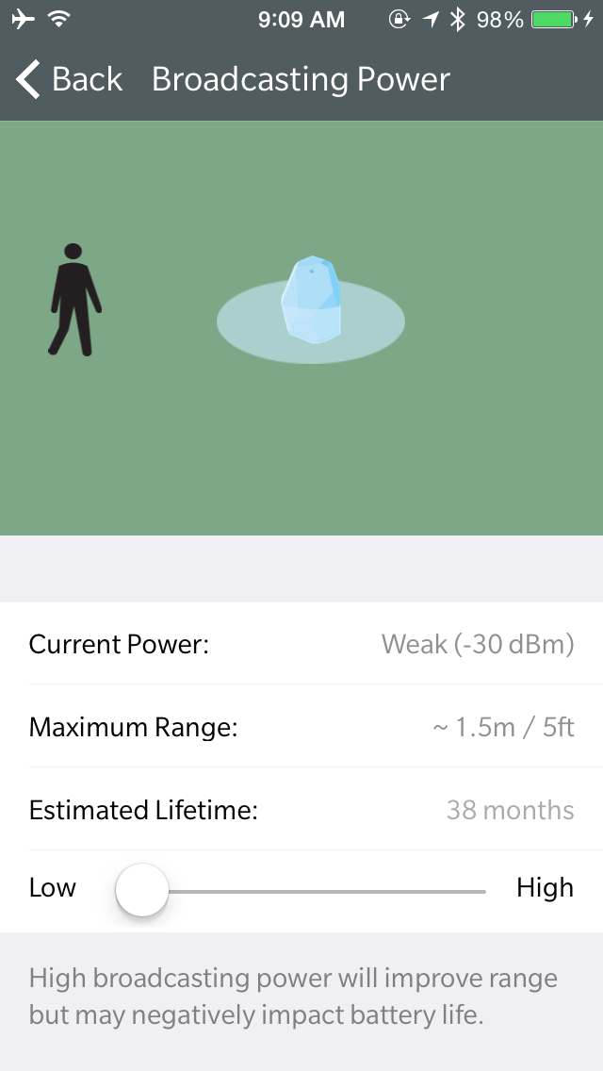

Slide 31
AndroidManifest.xml
<uses-permission android:name=
"android.permission.BLUETOOTH"/>
<uses-permission android:name=
"android.permission.BLUETOOTH_ADMIN"/>
<service android:name=
”com.estimote.sdk.service.BeaconService"
android:exported="false"/>
twitter: @jcleblanc | hashtag: #devnexus

Slide 32
Setting the Beacon Manager
private static final String ESTIMOTE_PROXIMITY_UUID =
"B9402F30-F5F7-466E-AFD9-25556B57GE6D";
private static final Region ALL_ESTIMOTE_BEACONS = new
Region("regionId", ESTIMOTE_PROXIMITY_UUID, null,
null);
private BeaconManager beaconManager = new
BeaconManager(activity);
twitter: @jcleblanc | hashtag: #devnexus

Slide 33
Setting the Listener
beaconManager.setRangingListener(new BeaconManager.RangingListener() {
@Override public void onBeaconsDiscovered(Region
region, List<Beacon> beacons) {
...
}
});
beaconManager.stopRanging(ALL_ESTIMOTE_BEACONS);
twitter: @jcleblanc | hashtag: #devnexus

Slide 34
The Beacon Object
getProximityUUID: Proximity UUID of the Beacon
getMajor: Major version of the beacon
getMinor: Minor version of the beacon
getMeasuredPower: Beacon measured power (in dBm)
getMacAddress: Beacon MAC address
getName: Display friendly beacon name
getRssi: Received Signal Strength Indication
twitter: @jcleblanc | hashtag: #devnexus

Slide 35
Getting Beacon Range
double distance = 1000.0;
Beacon beacon = null;
for (Beacon rangedBeacon : beacons) {
double currentDistance =
Utils.computeAccuracy(rangedBeacon);
if (currentDistance < distance && !
discovered.contains(rangedBeacon)){
distance = currentDistance;
beacon = rangedBeacon;
}
}
twitter: @jcleblanc | hashtag: #devnexus

Slide 36
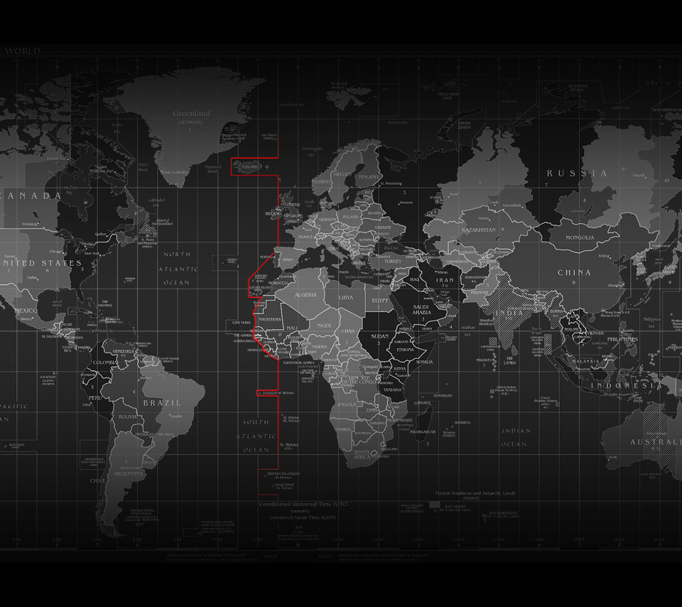
Playing with Location
twitter: @jcleblanc | hashtag: #devnexus
Notes:
http://blog.shinetech.com/2014/02/17/the-beacon-experiments-low-energy-bluetooth-devices-in-action/

Slide 37
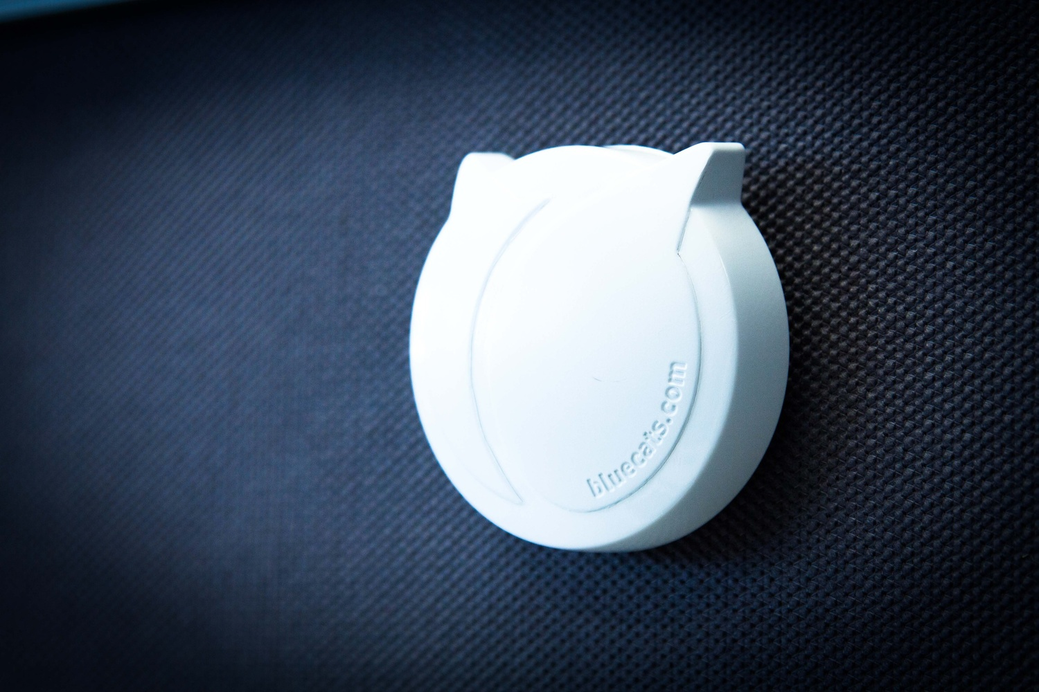
The Single Beacon
twitter: @jcleblanc | hashtag: #devnexus

Slide 38
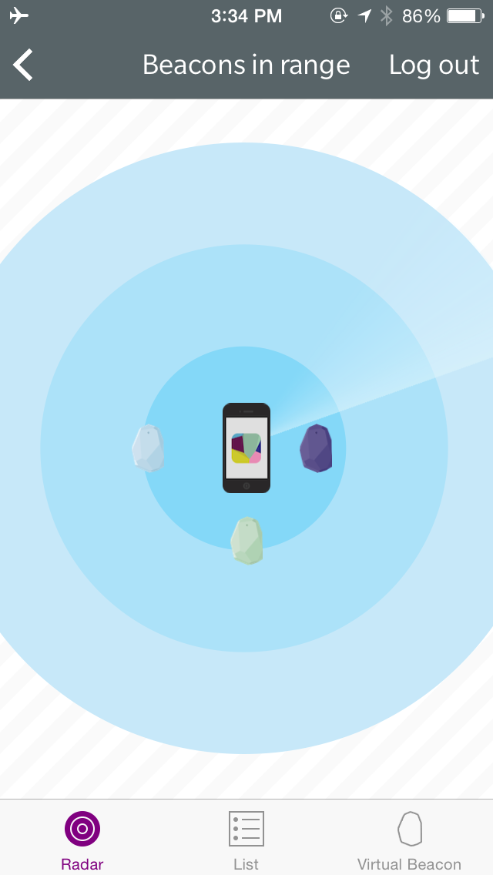
Indoor Accuracy Issues
twitter: @jcleblanc | hashtag: #devnexus

Slide 39
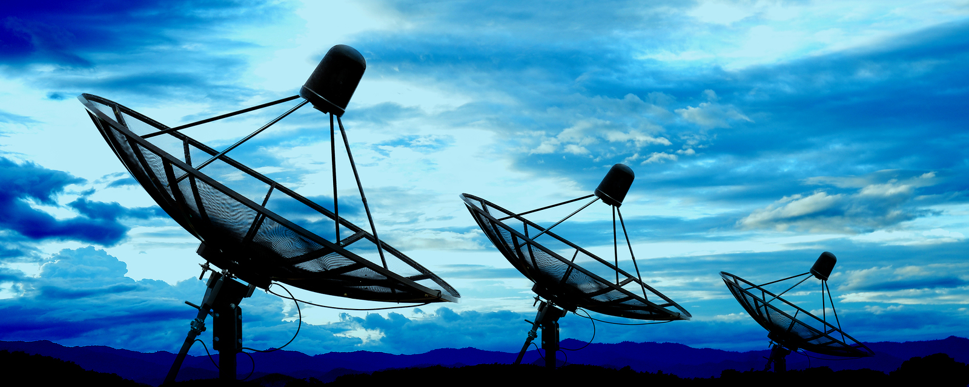
Improving Accuracy
twitter: @jcleblanc | hashtag: #devnexus

Slide 40
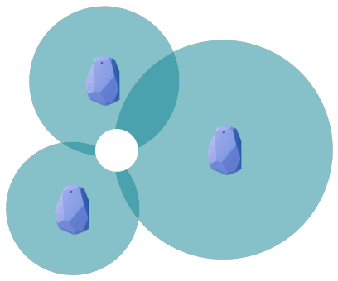
Beacon Triangulation
twitter: @jcleblanc | hashtag: #devnexus
Notes:
http://everything2.com/title/Triangulate
http://stackoverflow.com/questions/20332856/triangulate-example-for-ibeacons

Slide 41
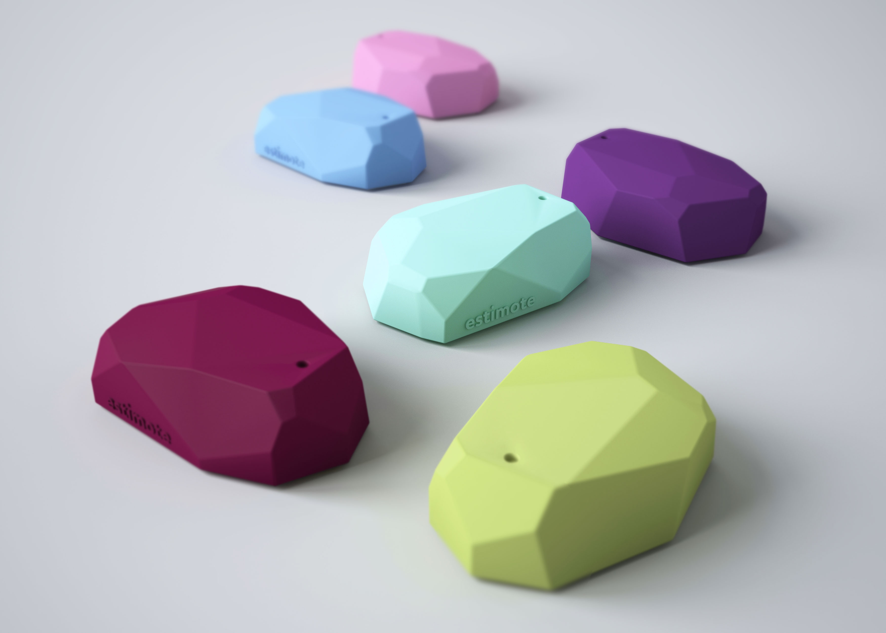
Deploying at Scale
twitter: @jcleblanc | hashtag: #devnexus
Notes:
Use multiple beacons and average the results

Slide 42
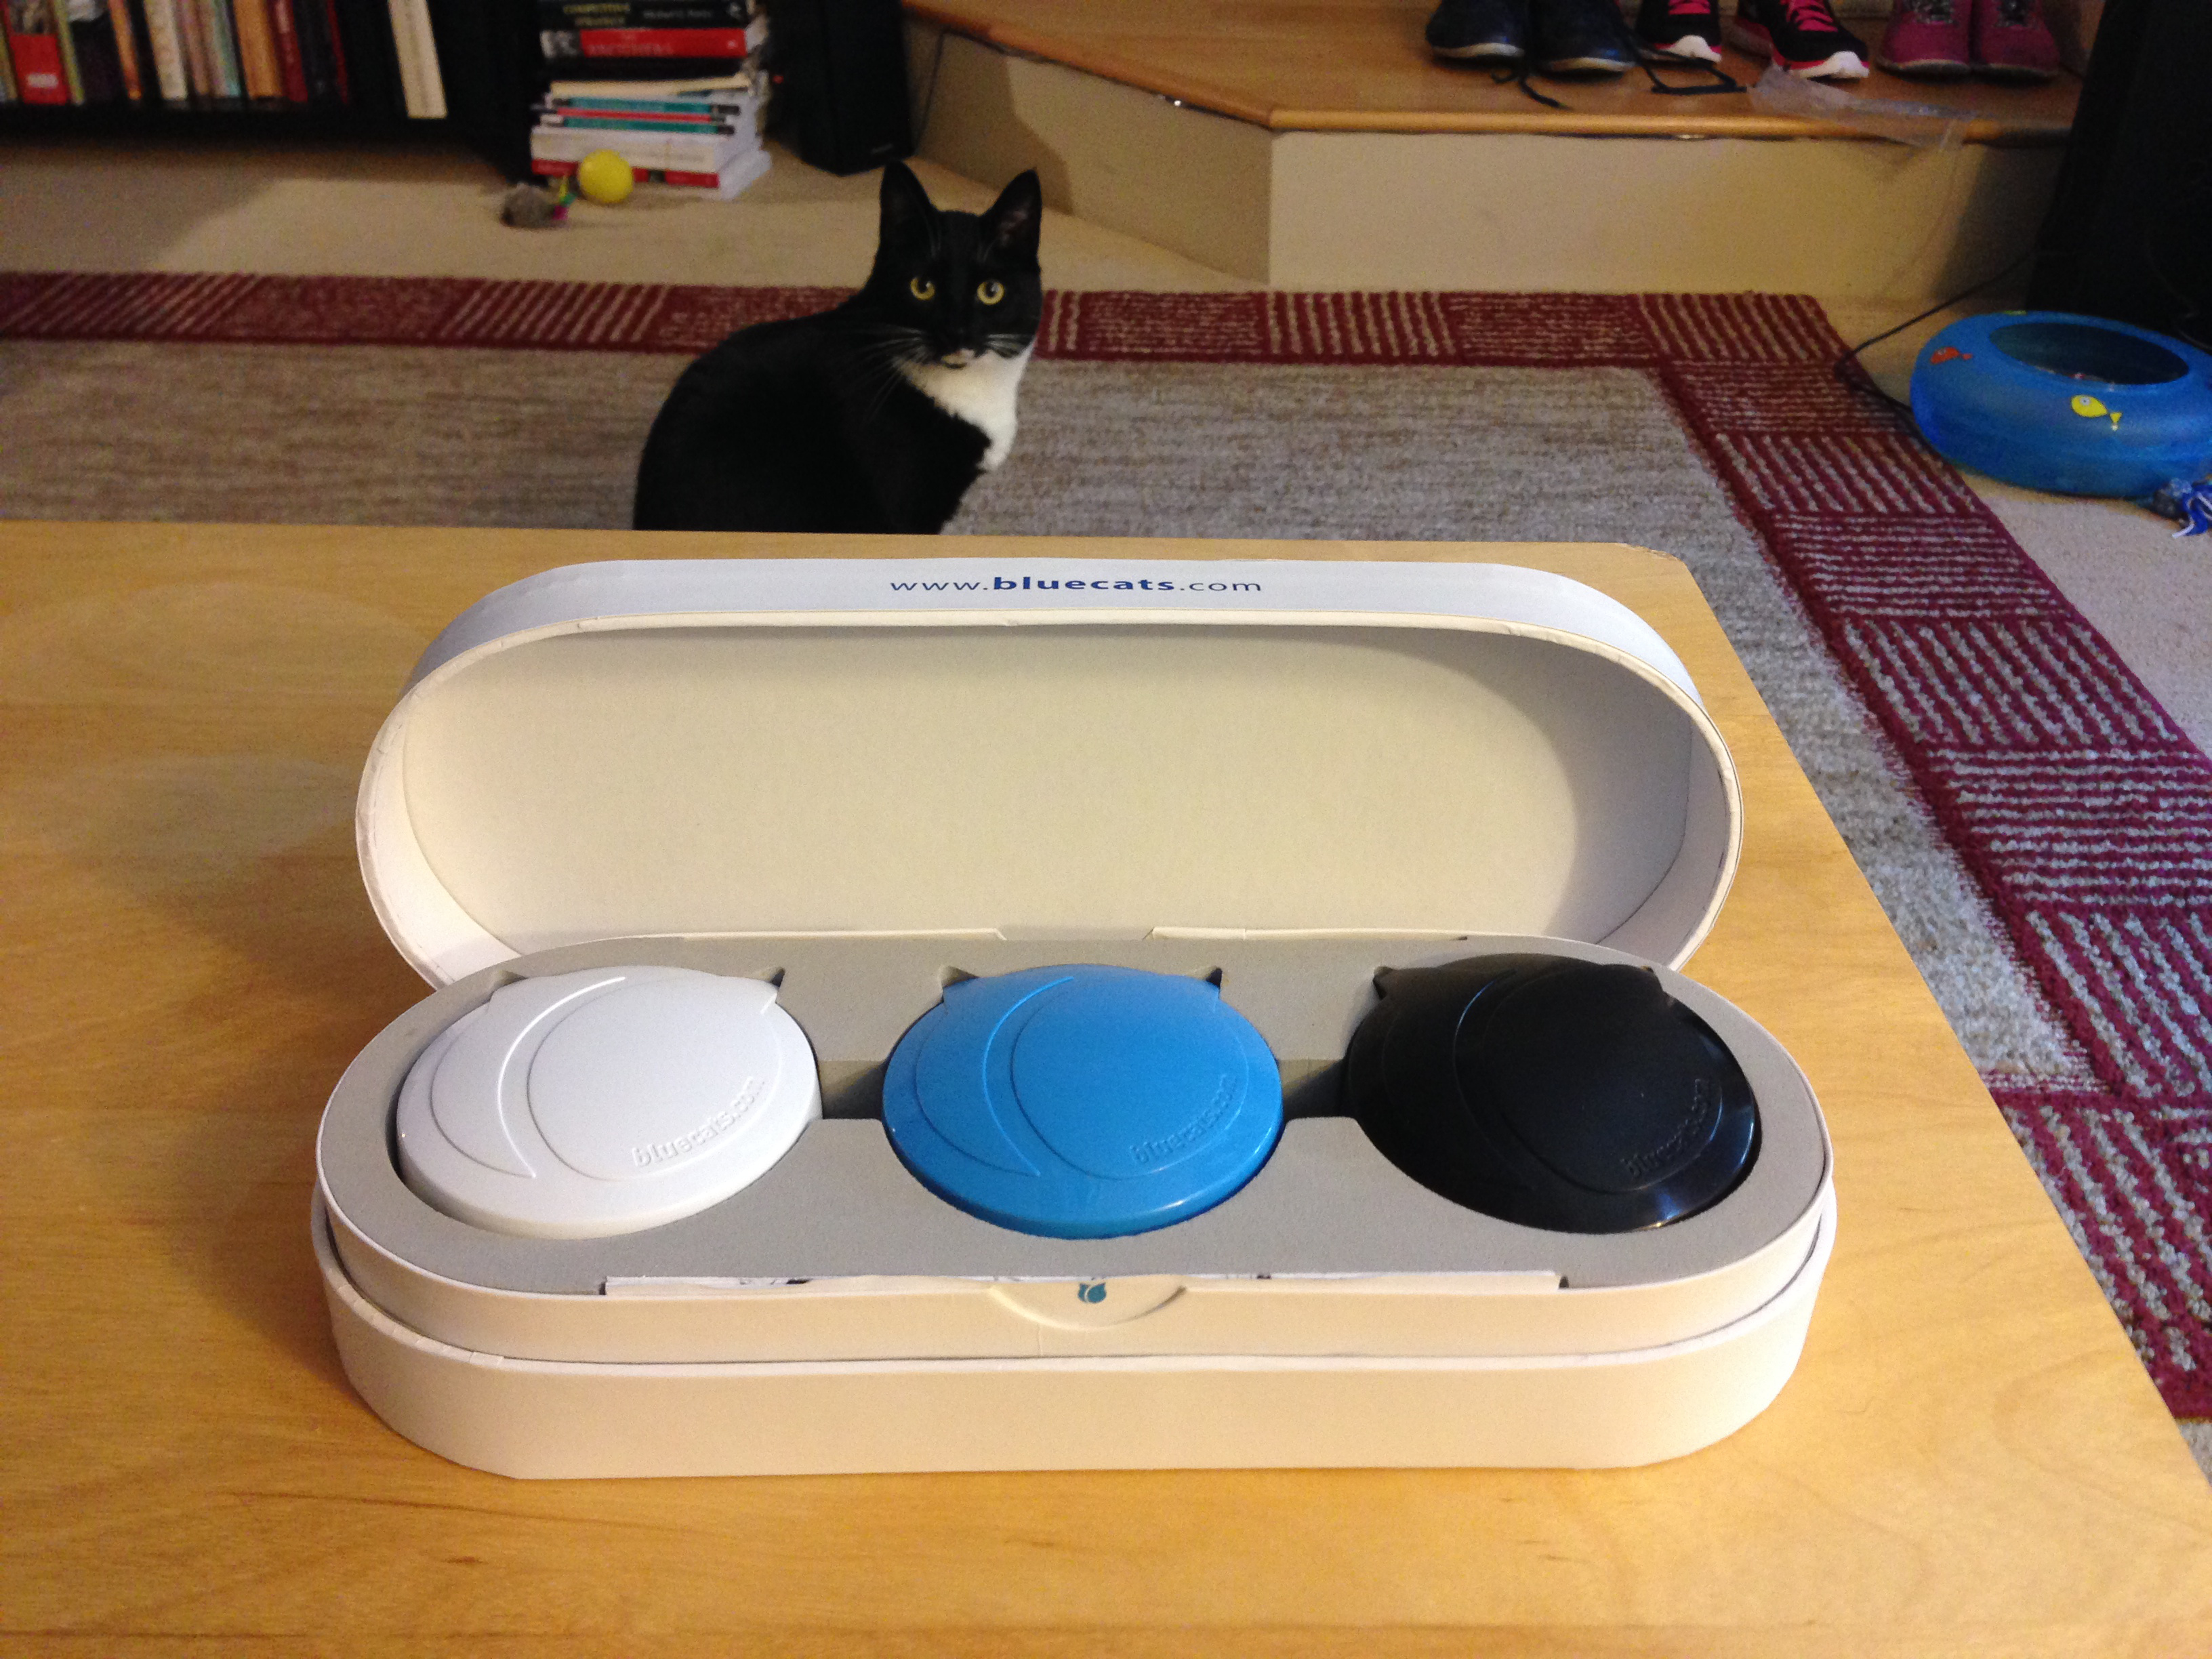
Beacon Wrap-up
twitter: @jcleblanc | hashtag: #devnexus
Notes:
http://blog.shinetech.com/2014/02/17/the-beacon-experiments-low-energy-bluetooth-devices-in-action/

Slide 43
Thank You!
http://bit.ly/beacon_talk
Jonathan LeBlanc (@jcleblanc)
Head of Global Developer Advocacy at PayPal + Braintree

